Slide 1
Dynamic Modeling and Simulation of a Power Plant Steam Condenser on the Siemens SPPA-T3000 Platform
Mohammad Odeh
Department of Mechanical and Aerospace Engineering
University of Central Florida
Committee Members
Dr. Tuhin Das
Dr. Tian Tian
Dr. Ranajay Ghosh
In collaboration with:

Slide 2
Introduction
Motivation
Improve current understanding
Gain insight into transient operation and response to perturbation
Fill gap in literature
Goal
Develop and validate a dynamic condenser model
Design the model such that it is generic (i.e. valid under any operational parameter)
Predict condenser performance in near real-time operation

Slide 3
Condensers
A subset of heat exchangers (HX)
Shell-and-Tube design
Circulating water for cooling
Freshwater, cooling tower
Extracts latent heat of vaporization
Condensate forms on surface of tube bundles

Slide 4
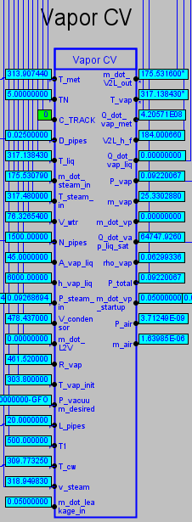
SPPA-T3000
Siemens Power Plant Automation T3000 (SPPA-T3000)
Visual Programming Language (VPL)
Equations consist of small building blocks
Embedded diagrams

Slide 5
Model Formulation
Lumped Control Volume (CV) formulation
Three subsystems
Metal CV
Vapor CV
Liquid CV
CV’s coupled with heat and mass transfer

Slide 6
Metal Control Volume (CV)

Slide 7
Metal CV – Formulation
Assumptions
Cylindrical pipes
Conduction only in the radial direction
Quasi-static (avoid solving Fourier series and Bessel functions at every time-step)
No fouling
Constant properties (i.e. ${dk}_{met}=0$)
Heat exchange with coolant at average inlet/outlet temperature
Stainless-Steel 316
Governing Equation (Energy balance):
$$→ {\left.\frac{d\left(mu\right)}{dt}\right|}_{met}=\left(enthalpy in −enthalpy out\right)+\left(heat in −heat out\right)$$
$$→{\left.mc_{p}\dot{T}\right|}_{met}={\dot{Q}}_{vap→met}−{\dot{Q}}_{met→cw}$$
Where,
$$→m_{met}=ρ_{met}∀_{met}=πρ_{met}L_{pipe}\left({R_{out}}^{2}−{R_{in}}^{2}\right)∙N_{pipes}$$

Slide 8
Metal CV – Formulation
$$Metal CV$$
$$T_{vap}$$
$$r_{out}$$
$$r_{in}$$
$${\dot{Q}}_{vap→met}$$
$$T_{vap}$$
$${\dot{Q}}_{met→cw}$$
$$r_{out}$$
$$T_{met,in}=T_{cw,avg}$$
$$T_{met,out}$$
$$r_{in}$$
Under steady-state conditions (assumption used to compute cw outlet temperature for sake of simplicity),
$$→{\dot{Q}}_{vap→met}={\dot{Q}}_{met,out→met,in}={\dot{Q}}_{met→cw}$$
$$→{\dot{Q}}_{conv.}={\dot{Q}}_{cond.}={\dot{Q}}_{conv.}$$
$$T_{met,in}=T_{cw,avg}$$
$$T_{met,out}$$

Slide 9
Metal CV – Formulation
Heat transfer from metal to cooling water (cw),
$$→{\dot{Q}}_{met→cw }={\dot{Q}}_{met,out→met,in}=\frac{2π{k_{met}L}_{pipe}\left(T_{met}−T_{cw,avg}\right)}{\ln\left({r_{out}}/{r_{in}}\right)}∙N_{pipes}$$
Cooling water (cw) outlet temperature is obtained from,
$$→{\dot{Q}}_{met→cw}={\dot{m}}_{cw}c_{p}\left(T_{cw,out}−T_{cw,in}\right)$$
Re-arranging,
$$→T_{cw,out}=\frac{{\dot{Q}}_{met→cw}}{{\dot{m}}_{cw}c_{p}}+T_{cw,in}$$

Slide 10
Metal CV – Temperature Evolution
Temperature evolution found as follows,
$$→T_{met}\left(t\right)=\int_{t_{0}}^{t}{\frac{{\dot{Q}}_{vap→met}−{\dot{Q}}_{met→cw}}{m_{met}c_{p,met}}}dt+T_{met}\left(t=t_{0}\right)$$

Slide 11
Vapor Control Volume (CV)

Slide 12
Vapor CV – Formulation
Assumptions
Ideal gas
At saturation
No radiative heat transfer
No non-condensables
Filmwise condensation
Governing Equation (Energy balance):
$$→{\left.\dot{m}u\right|}_{vap}+{\left.m\dot{u}\right|}_{vap}=\left(\sum_{in}{\dot{m}h}−\sum_{out}{\dot{m}h}\right)+\left(\sum_{in}{\dot{Q}}−\sum_{out}{\dot{Q}}\right)$$
Where internal energy $\left(u\right)$ is computed as,
$$→u=h−Pv$$
And,
$$→c_{v}≡{\left.\frac{δq}{dT}\right)}_{v=cte}where δq=du+δw=du+Pdv$$
$$∴\boxed{\dot{u}=c_{v}\dot{T}}$$

Slide 13
Vapor CV – Formulation
Governing Equation (Mass balance):
$$→{\dot{m}}_{vap}={\dot{m}}_{in}−{\dot{m}}_{V2L}+{\dot{m}}_{L2V}−{\dot{m}}_{vp}+{\dot{m}}_{other}$$
Expanding,
$$→\sum_{in}{\dot{m}h}−\sum_{out}{\dot{m}h}={\left.\dot{m}h\right|}_{in}−{\left.\dot{m}h\right|}_{V2L}+{\left.\dot{m}h\right|}_{L2V}−{\left.\dot{m}h\right|}_{vp}+{\left.\dot{m}h\right|}_{other}$$
$$→\sum_{in}{\dot{Q}}−\sum_{out}{\dot{Q}}=−\left[{\dot{Q}}_{vap→met}+{\dot{Q}}_{vap→liq}\right]$$
$$=−\left[{\left.HA\right|}_{vap→met}\left(T_{vap}−T_{met}\right)+{\left.HA\right|}_{vap→liq}\left(T_{vap}−T_{liq}\right) \right]$$

Slide 14
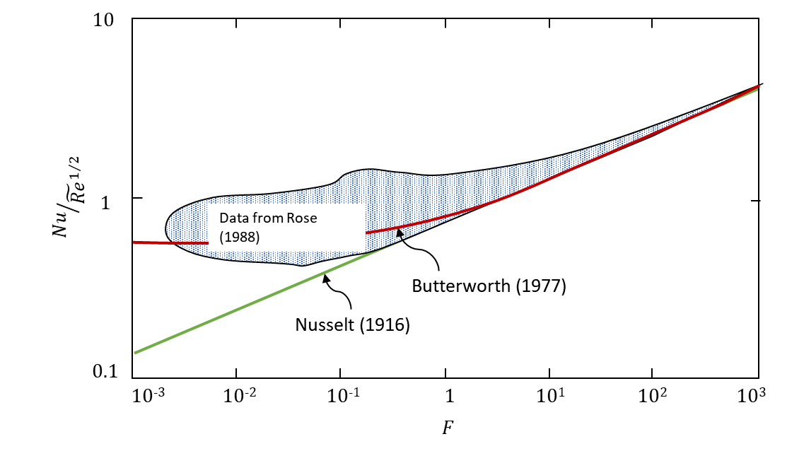
Vapor CV – HTC Estimation
Where $(A)$ is the surface area,
$$→A_{surface}=πD_{out}L_{pipe}∙N_{pipes}$$
Convective heat transfer coefficient $(H)$,
$$→Nu=0.416{\left\{1+{\left(1+9.47F\right)}^{1/2}\right\}}^{1/2}{\tilde{Re}}^{1/2}$$
And,
$$→Nu=\frac{{\left.H\right|}_{vap→met}D_{out}}{k_{f}}$$

Slide 15
Vapor CV – HTC Estimation
The two-phase Reynolds number $\left(\tilde{Re}\right)$ is defined as:
$$→\tilde{Re}=\frac{ρ_{f}v_{g}D_{out}}{μ_{f}}$$
And the non-dimensional factor $(F)$ is,
$$→F=\frac{gD_{out}μ_{f}h_{fg}}{{v_{g}}^{2}k_{f}\left(T_{vap}−T_{met}\right)}$$

Slide 16
Vapor CV – HTC Estimation
The dynamic viscosity of the condensate film $\left(μ_{f}\right)$ is approximated by:
$→μ_{f}=μ_{f}(T_{avg})=A∙{10}^{\frac{B}{T−C}}$, where $\left\{\begin{aligned}A=2.44×{10}^{−5} Pa∙s \\ B=247.8 K \\ C=140.0 K \end{aligned}\right.$
The thermal conductivity of the condensate film $\left(k_{f}\right)$ is approximated by:
$→k_{f}=k_{f}\left(T_{avg}\right)=A∙T^{2}+B∙T+C$, where $\left\{\begin{aligned}A=−8.354×{10}^{−6}\frac{W}{m∙K^{3}} \\ B= 6.530×{10}^{−3}\frac{W}{m∙K^{2}} \\ C= −0.598 \frac{W}{m∙K}\end{aligned}\right.$
Where $\left(T_{avg}\right)$ is the temperature of the condensate film:
$$→T_{avg}=\frac{T_{vap}+T_{met}}{2}$$

Slide 17
Vapor CV – Correction Factor
The effect of the superheat is usually small, but can be corrected for using the expression derived by Chen (1961):
$$→H_{Corrected}=H{\left(1−ζ\right)}^{1/4}$$
Where,
$$→ζ=\frac{c_{p,vap}\left(T_{vap}−T_{sat}\right)}{h_{fg}}$$

Slide 18
Vapor CV – Correction Factor
In accordance to the IAPWS 1955 formulation,
$$→c_{p,vap}\left(P, T\right)=E\left(T\right)+F\left(T\right)\left(P−P_{tr}\right), where P_{tr}=611.657 Pa$$
$$→c_{v,vap}\left(P, T\right)=c_{p,vap}\left(P, T\right)−R$$
Where,
$$→E\left(T\right)=A_{E}+B_{E}T+C_{E}T^{2}$$
$$→F\left(T\right)=\frac{1}{A_{F}+B_{F}T+C_{F}T^{2}}$$
 | $$T<50 ℃$$ | $$T>50 ℃$$
$$A_{E}$$ | $$1877.2$$ | $$1856.1$$
$$B_{E}$$ | $$−0.49545$$ | $$0.28056$$
$$C_{E}$$ | $$8.1818×{10}^{−3}$$ | $$6.9444×{10}^{−4}$$
$$A_{F}$$ | $$22.537$$ | $$22.537$$
$$B_{F}$$ | $$0.49321$$ | $$0.49321$$
$$C_{F}$$ | $$0.048927$$ | $$0.048927$$

Slide 19
Vapor CV – Temperature Evolution & Mass Transfer
Redefine Governing Equation:
$$→m_{vap}c_{v,vap}{\dot{T}}_{vap}=E_{in}−E_{vp}+E_{L2V}−E_{V2L}+E_{other}+{\dot{Q}}_{Net}$$
Where,
$$E_{in} ={\dot{m}}_{in} \left(h_{in} −u_{vap}\right)$$
$$E_{vp} ={\dot{m}}_{vp} \left(h_{vp} −u_{vap}\right)$$
$$E_{L2V} ={\dot{m}}_{L2V} \left(h_{L2V } −u_{vap}\right)$$
$$E_{V2L} ={\dot{m}}_{V2L} \left(h_{V2L} −u_{vap}\right)$$
$$E_{other}={\dot{m}}_{other}\left(h_{other}−u_{vap}\right)$$

Slide 20
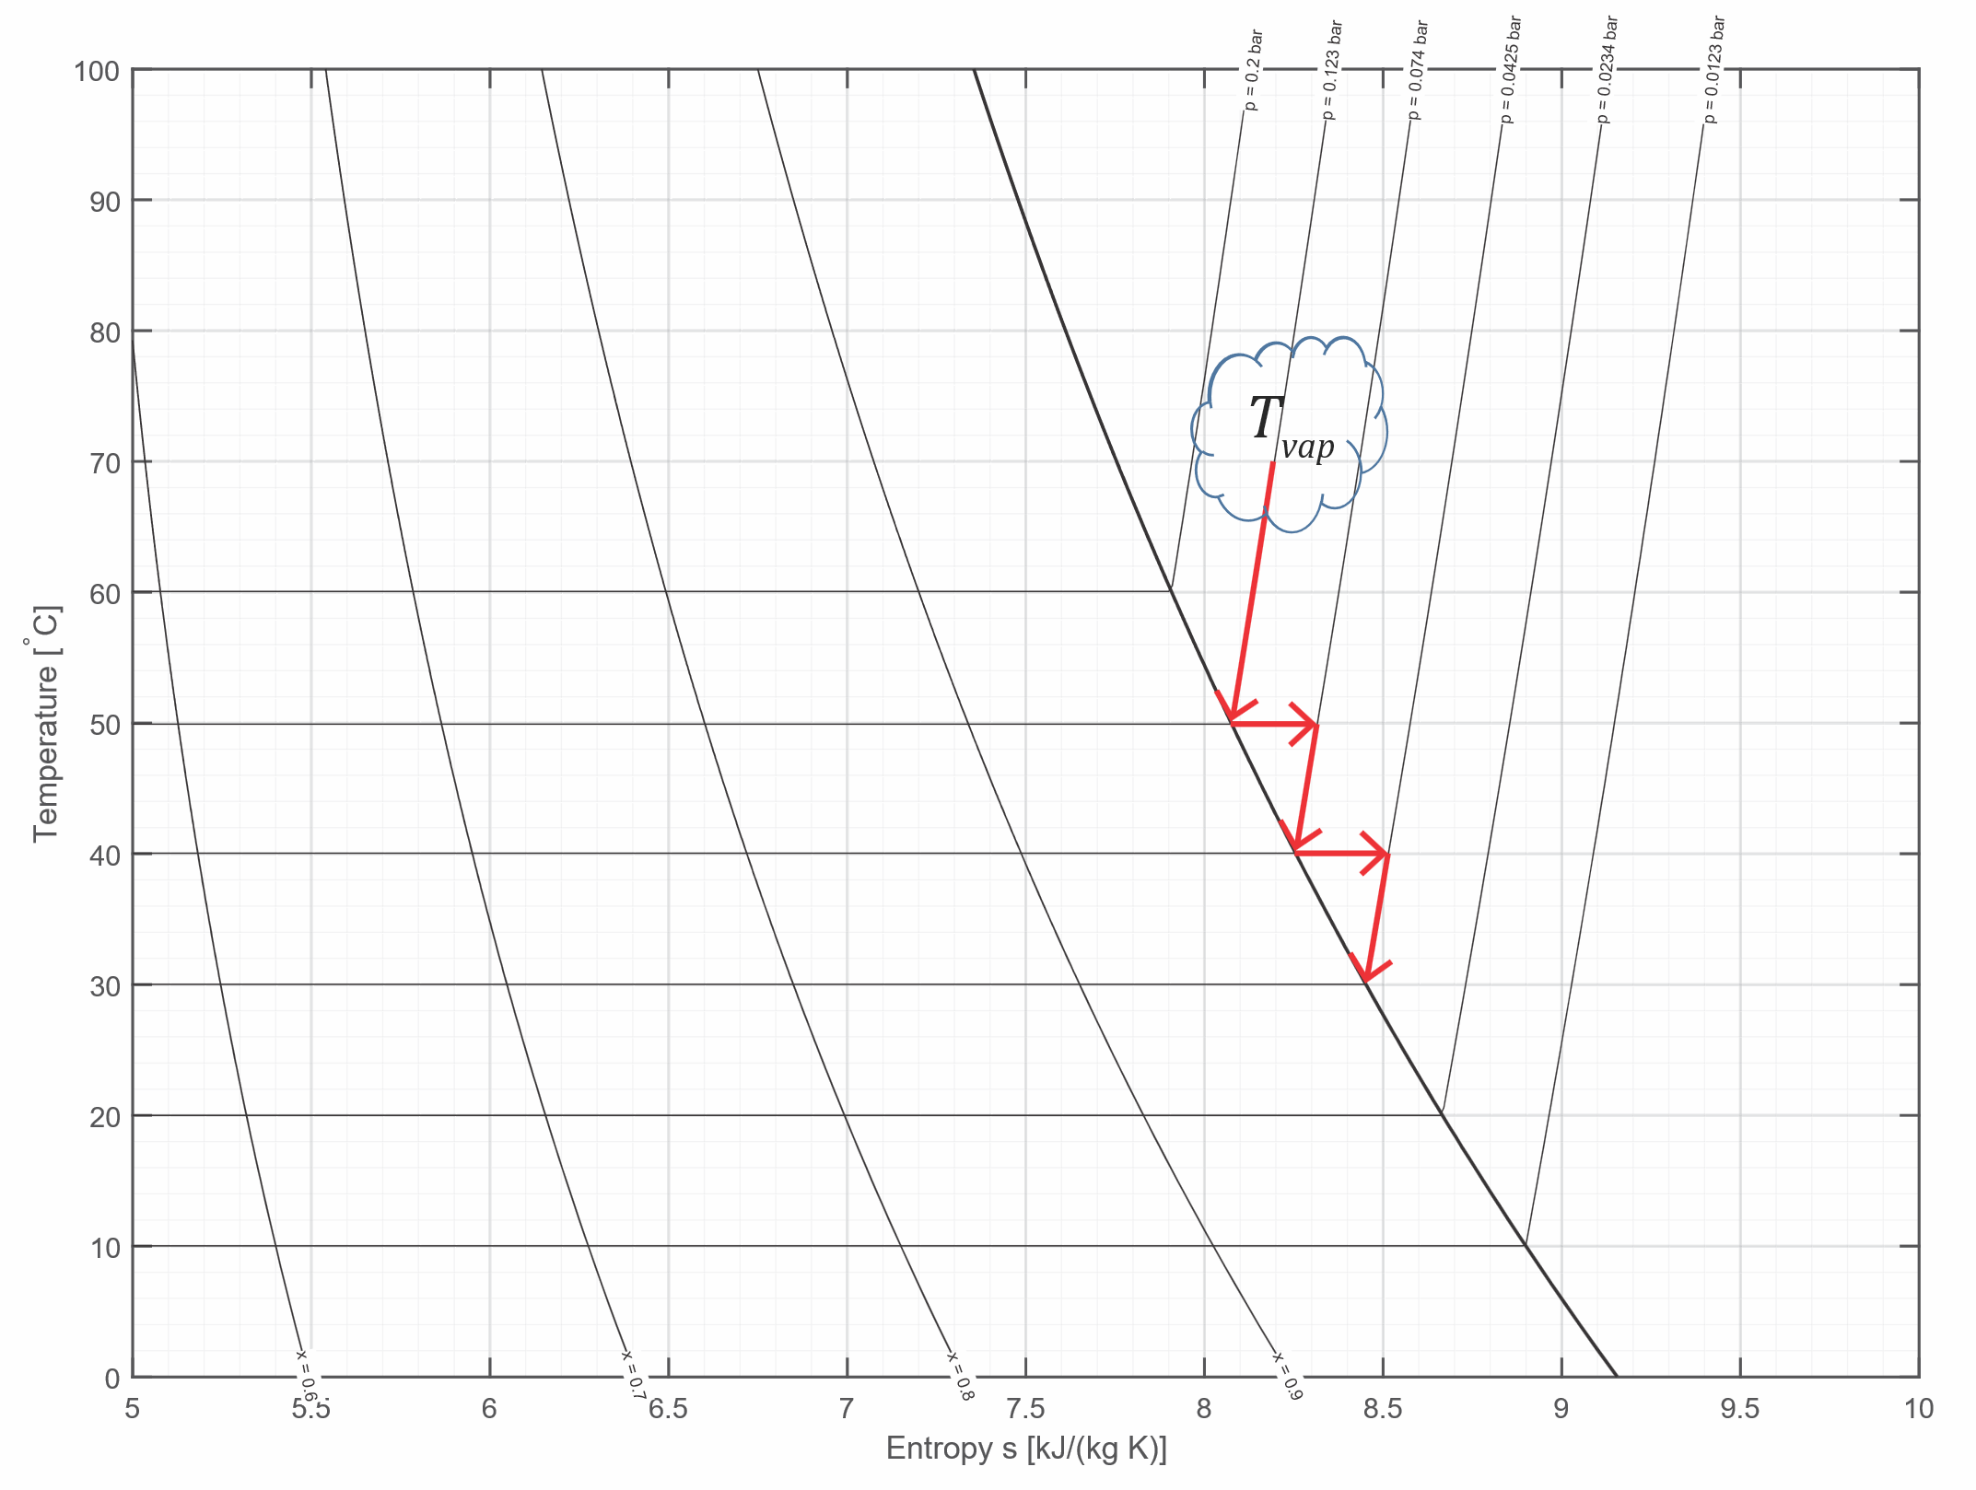
Vapor CV – Mode 1
Cooling mode:
Temperature drop
No mass transfer
$$→T_{vap}>T_{dp}\left(P_{vap}\right)+ε , {\dot{m}}_{V2L}=0 and {\dot{T}}_{vap}<0$$
Then,
$$∴\boxed{T_{vap}\left(t\right)=\int_{t_{0}}^{t}{\frac{E_{in}−E_{vp}+E_{L2V}+E_{other}+{\dot{Q}}_{Net}}{m_{vap}c_{v,vap}}}dt+T_{vap}\left(t=t_{0}\right)}$$

Slide 21
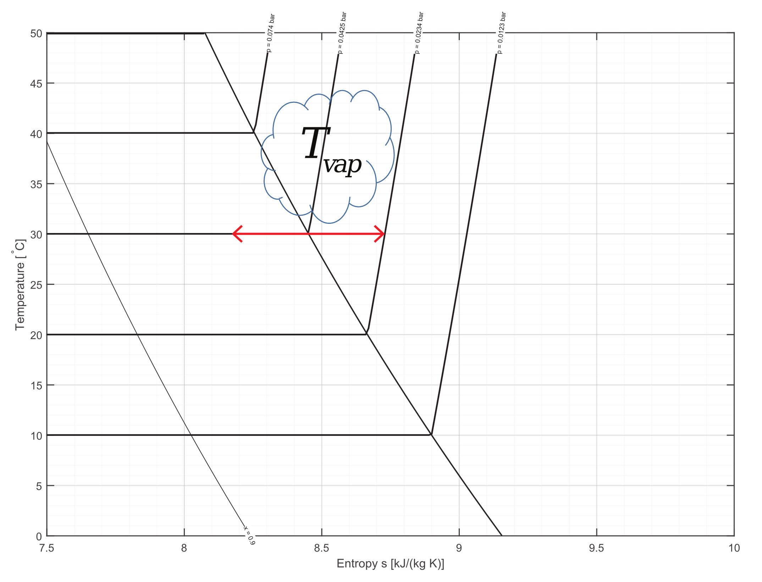
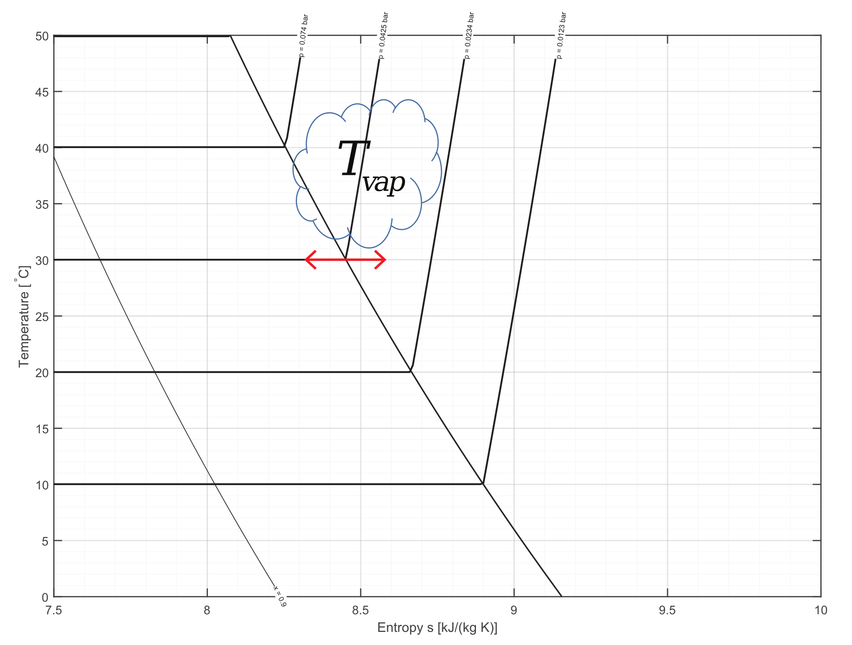
Vapor CV – Mode 2
Condensation mode:
Mass transfer @ $T_{vap}=cte$
Depressurization/Pressurization
$$→T_{vap}≈T_{dp}\left(P_{vap}\right)±ε , {\dot{m}}_{V2L}>0 and {\dot{T}}_{vap}=0$$
Then,
$$∴\boxed{{\dot{m}}_{V2L}=\frac{E_{in}−E_{vp}+E_{L2V}+E_{other}+{\dot{Q}}_{Net}}{\left(h_{V2L}−u_{vap}\right)}}$$
$$∴\boxed{m_{vap}\left(t\right)=\int_{t_{0}}^{t}{\left({\dot{m}}_{in}−{\dot{m}}_{V2L}+{\dot{m}}_{L2V}−{\dot{m}}_{vp}+{\dot{m}}_{other}\right)}dt+m_{vap}\left(t=t_{0}\right)}$$

Slide 22
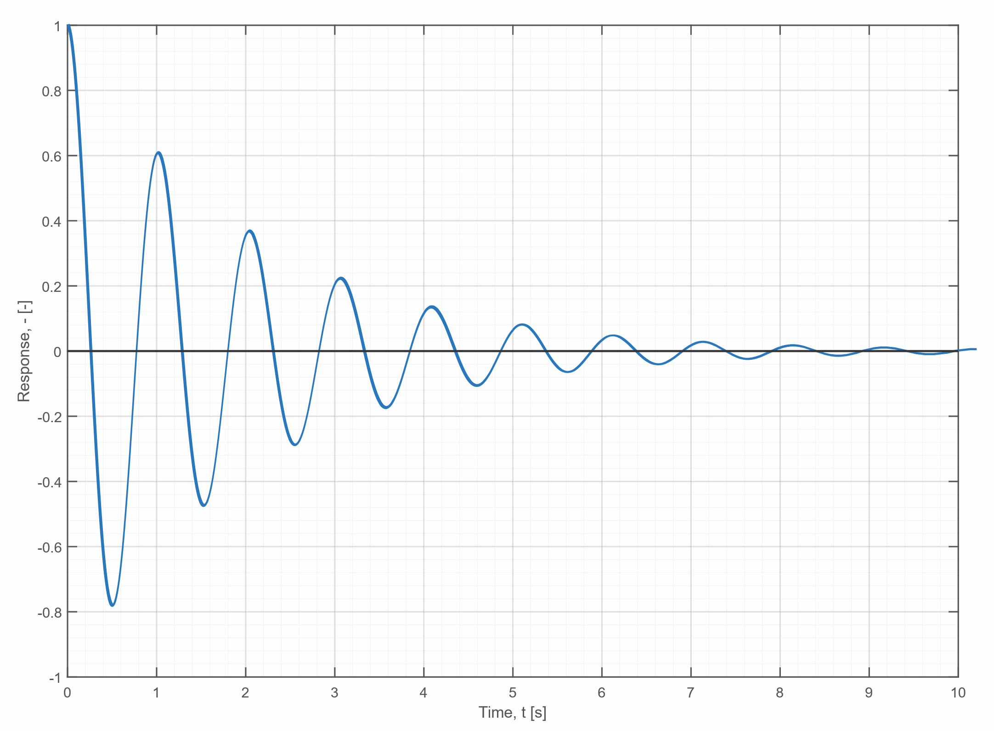
Vapor CV – Mode 2
Condensation mode – Oscillatory Response:

Slide 23
Vapor CV – Mode 3
Heating-Condensing mode:
Incoming steam heats up vapor space
Now inside TS dome
$$→T_{vap}<T_{dp}\left(P_{vap}\right)−ε , {\dot{m}}_{V2L}>0 and {\dot{T}}_{vap}>0$$
Then,
$$∴\boxed{T_{vap}\left(t\right)=\int_{t_{0}}^{t}{\frac{E_{in}−E_{vp}+E_{L2V}−E_{V2L}+E_{other}+{\dot{Q}}_{Net}}{m_{vap}c_{v,vap}}}dt+T_{vap}\left(t=t_{0}\right)}$$

Slide 24
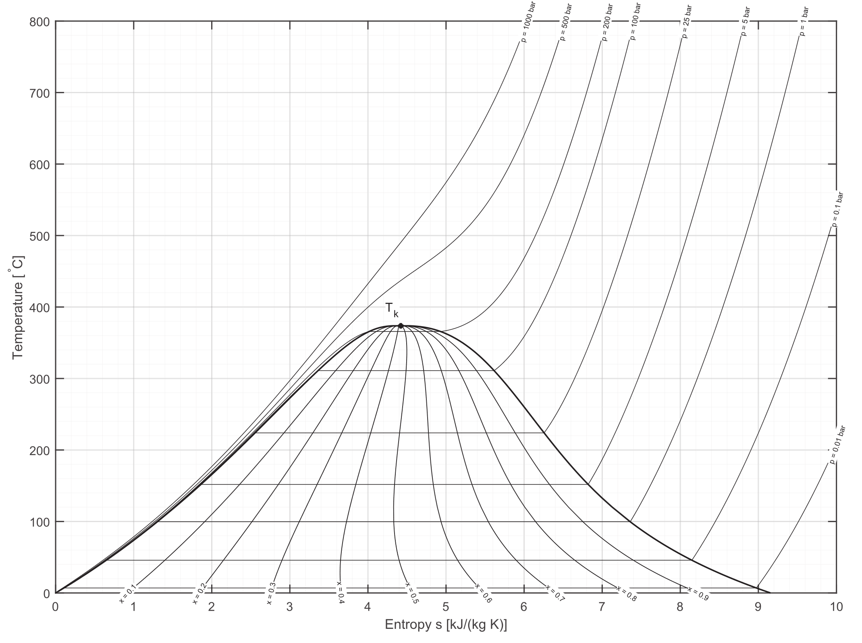
TS Diagram

Slide 25
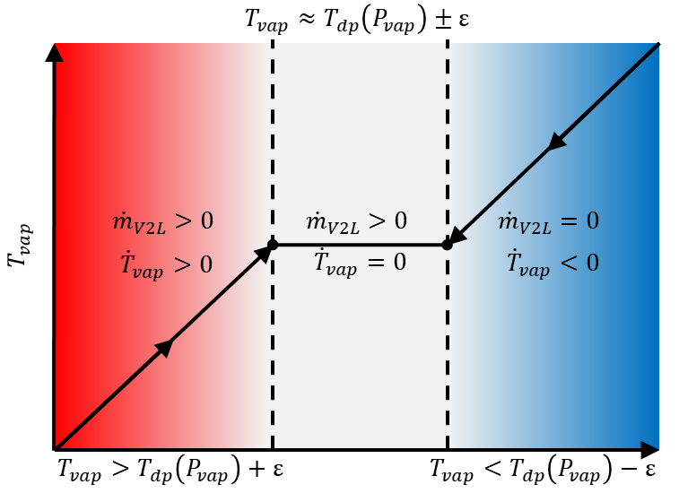
Vapor CV – Modes Summarized
Summary of 3 modes:
$$→if\left\{\begin{aligned}T_{vap}≈T_{dp}\left(P_{vap}\right)±ε , then {\dot{m}}_{V2L}>0 and {\dot{T}}_{vap}=0 \\ T_{vap}>T_{dp}\left(P_{vap}\right)+ε ,then {\dot{m}}_{V2L}=0 and {\dot{T}}_{vap}<0 \\ T_{vap}<T_{dp}\left(P_{vap}\right)−ε , then {\dot{m}}_{V2L}>0 and {\dot{T}}_{vap}>0\end{aligned}\right.$$
Where $ε=0.01T_{dp}\left(P_{vap}\right)$

Slide 26
Vapor CV
The attemperation process involves de-superheating the steam down to about 3℃ (based on the engineer’s discretion) above its saturation temperature. The process can be modeled mathematically as follows,
$$→{\left.\dot{m}h\right|}_{cw}+{\left.\dot{m}h\right|}_{s}={\dot{m}}_{cw}h_{d}+{\dot{m}}_{s}h_{d}$$
$$∴{\dot{m}}_{cw}=\frac{{\dot{m}}_{s}\left(h_{d}−h_{s}\right)}{\left(h_{cw}−h_{s}\right)}$$
Where $\left({\dot{m}}_{cw}\right)$ is mass flow rate at which atomized coolant water is added into the stream path, $\left(h_{s}\right)$ is the enthalpy of the superheated steam, and $\left(h_{d}\right)$ is the desuperheated steam enthalpy.

Slide 27
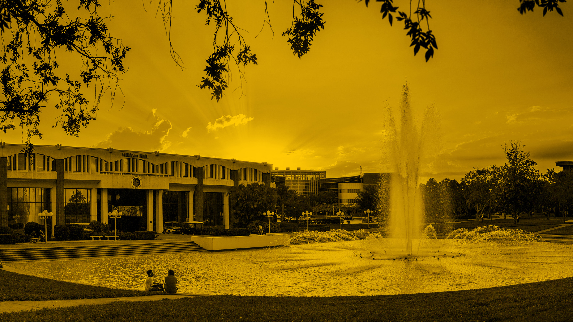
Liquid Control Volume (CV)

Slide 28
Liquid CV – Formulation
Assumptions
Pure water
Initially at CW temperature
No heat transfer with the condenser hull.
Governing Equation (Energy balance):
$$→{\left.\dot{m}u\right|}_{liq}+{\left.m\dot{u}\right|}_{liq}=\left(\sum_{in}{\dot{m}h}−\sum_{out}{\dot{m}h}\right)+\left(\sum_{in}{\dot{Q}}−\sum_{out}{\dot{Q}}\right)$$
Where internal energy $\left(u\right)$ is computed as,
$$→u=h−Pv$$
And,
$$→c_{v}≡{\left.\frac{δq}{dT}\right)}_{v=cte}where δq=du+δw=du+Pdv$$
$$∴\boxed{\dot{u}=c_{v}\dot{T}(≈c_{P}\dot{T}} in the case of liquids/solids)$$

Slide 29
Liquid CV – Formulation
Governing Equation (Mass balance):
$$→{\dot{m}}_{liq}={\dot{m}}_{V2L}−{\dot{m}}_{L2V}−{\dot{m}}_{out}+{\dot{m}}_{other}$$
Expanding,
$$→\sum_{in}{\dot{m}h}−\sum_{out}{\dot{m}h}={\left.\dot{m}h\right|}_{V2L}−{\left.\dot{m}h\right|}_{L2V}−{\left.\dot{m}h\right|}_{out}+{\left.\dot{m}h\right|}_{other}$$
$$→\sum_{in}{\dot{Q}} −\sum_{out}{\dot{Q}} ={\dot{Q}}_{vap→liq}={\left.HA\right|}_{vap→liq}\left(T_{vap}−T_{liq}\right)$$

Slide 30
Liquid CV – Temperature Evolution & Mass Transfer
Redefine Governing Equation:
$$→m_{liq}c_{v,liq}{\dot{T}}_{liq}=E_{V2L}−E_{L2V}−E_{out}+E_{other}+{\dot{Q}}_{Net}$$
Where,
$$E_{V2L} ={\dot{m}}_{V2L} \left(h_{V2L} −u_{liq}\right)$$
$$E_{L2V} ={\dot{m}}_{L2V} \left(h_{L2V } −u_{liq}\right)$$
$$E_{out} ={\dot{m}}_{out} \left(h_{out} −u_{liq}\right)$$
$$E_{other}={\dot{m}}_{other}\left(h_{other}−u_{liq}\right)$$
In addition, note that,
$$→h_{V2L}=h_{f}\left(T_{vap}\right) AND h_{L2V}=h_{g}\left(T_{liq}\right) AND h_{out}=h_{f}\left(T_{liq}\right)$$

Slide 31
Liquid CV – Mode 1
Mass transfer constraint:
Variation in temperature
No mass transfer
$$→P_{liq}=P_{sat}\left(T_{liq}\right)<P_{vap} , {\dot{m}}_{L2V}=0 and {\dot{T}}_{liq}≠0$$
Then,
$$∴\boxed{T_{liq}\left(t\right)=\int_{t_{0}}^{t}{\frac{E_{V2L}−E_{out}+E_{other}+{\dot{Q}}_{Net}}{m_{liq}c_{v,liq}}}dt+T_{liq}\left(t=t_{0}\right)}$$

Slide 32
Liquid CV – Mode 2
Temperature constraint:
Flash steam generation (evaporation)
No variation in temperature
$$→P_{liq}=P_{sat}\left(T_{liq}\right)>P_{vap} , {\dot{m}}_{L2V}>0 and {\dot{T}}_{liq}=0$$
Then,
$$∴\boxed{{\dot{m}}_{L2V}=\frac{E_{V2L}−E_{out}+E_{other}+{\dot{Q}}_{Net}}{\left(h_{L2V}−u_{liq}\right)}}$$
$$∴\boxed{m_{liq}\left(t\right)=\int_{t_{0}}^{t}{\left({\dot{m}}_{V2L}−{\dot{m}}_{L2V}−{\dot{m}}_{out}+{\dot{m}}_{other}\right)}dt+m_{liq}\left(t=t_{0}\right)}$$

Slide 33
Liquid CV – Volume Determination
Volume of CV determined as follows
$$V_{liq}=\frac{m_{liq}}{ρ_{liq}}$$
The American Institute of Chemical Engineers (AIChE) proposed the following,
$→ρ_{liq}\left(T\right)=\frac{A}{B^{1+{\left(1−\frac{T}{C}\right)}^{D}}}$, where $\left\{\begin{aligned}A=0.14395 \\ B=0.01120 \\ C=649.727 \\ D=0.05107\end{aligned}\right.$

Slide 34
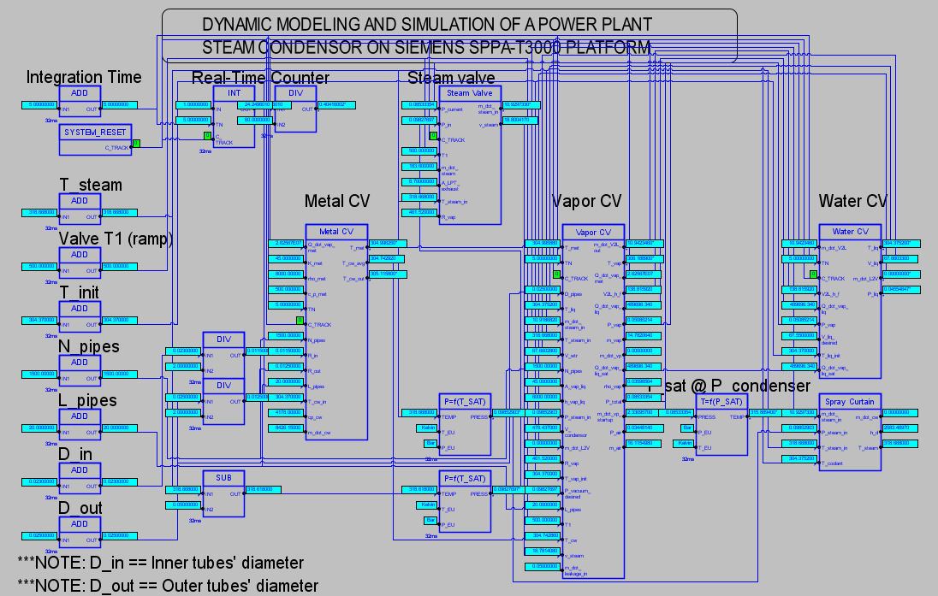

Slide 35
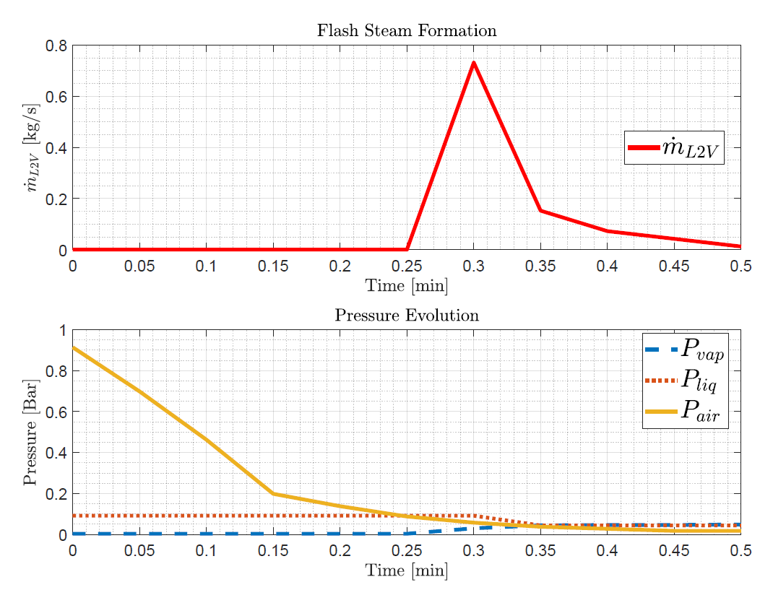
Results and Validation – Flash Steam

Slide 36
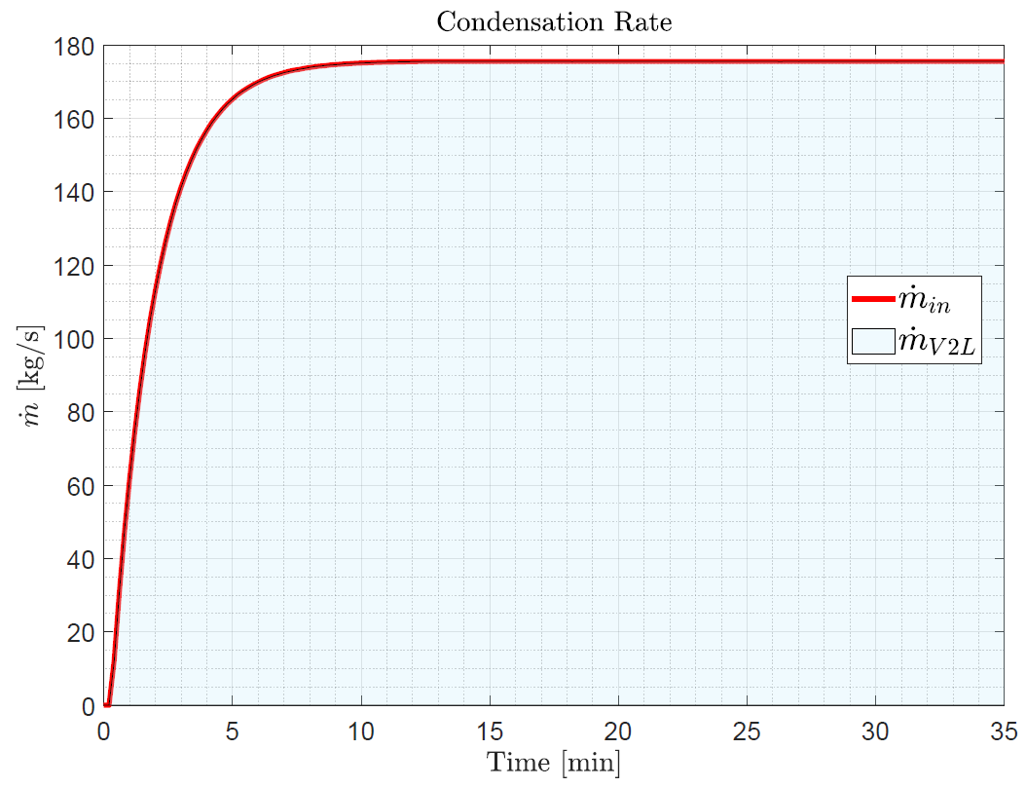
Results and Validation – Mass Transfer

Slide 37
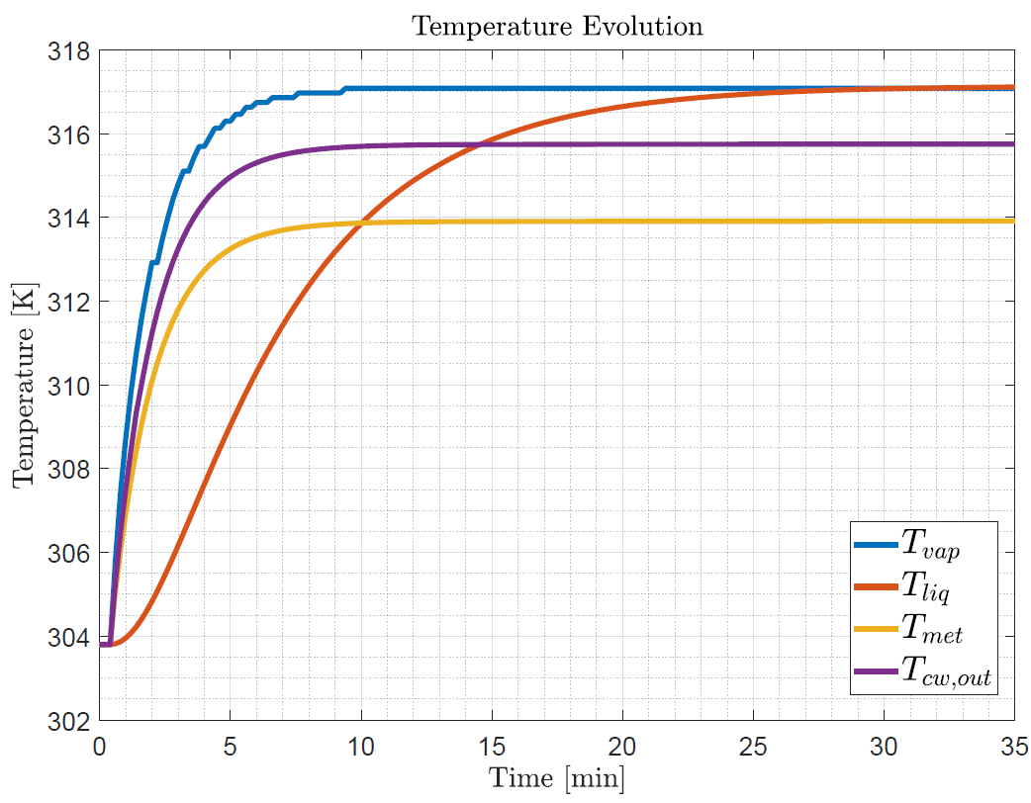
Results and Validation – Temperature Evolution

Slide 38
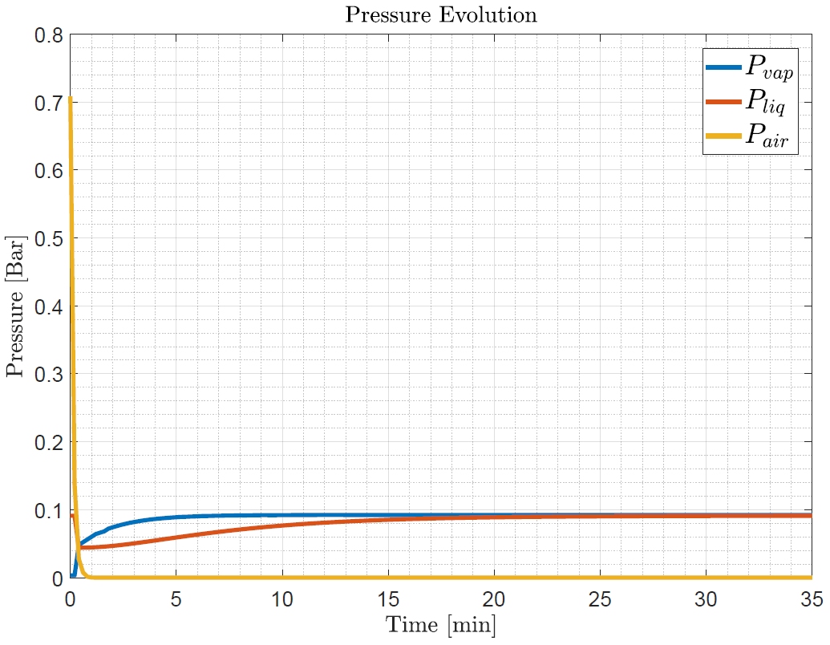
Results and Validation – Pressure Evolution

Slide 39
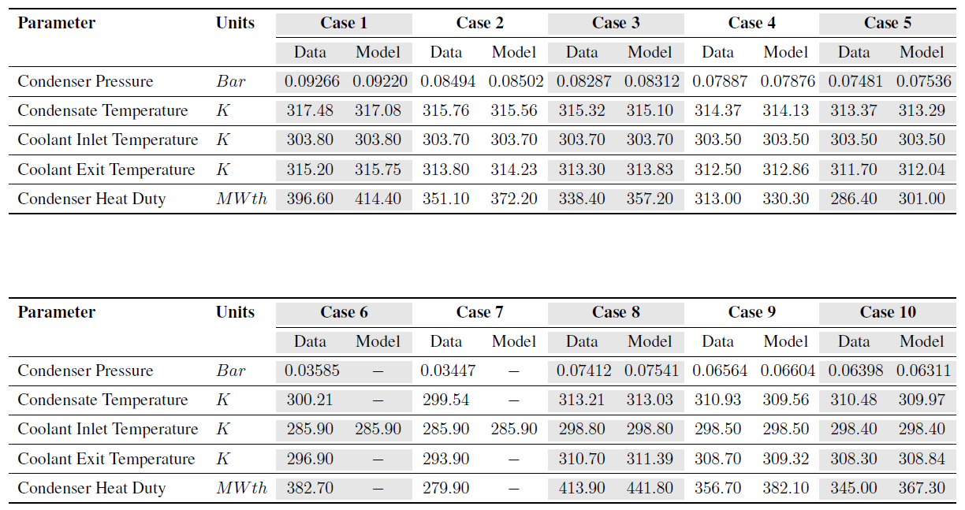
Results and Validation – Comparison with Siemens Provided Data

Slide 40
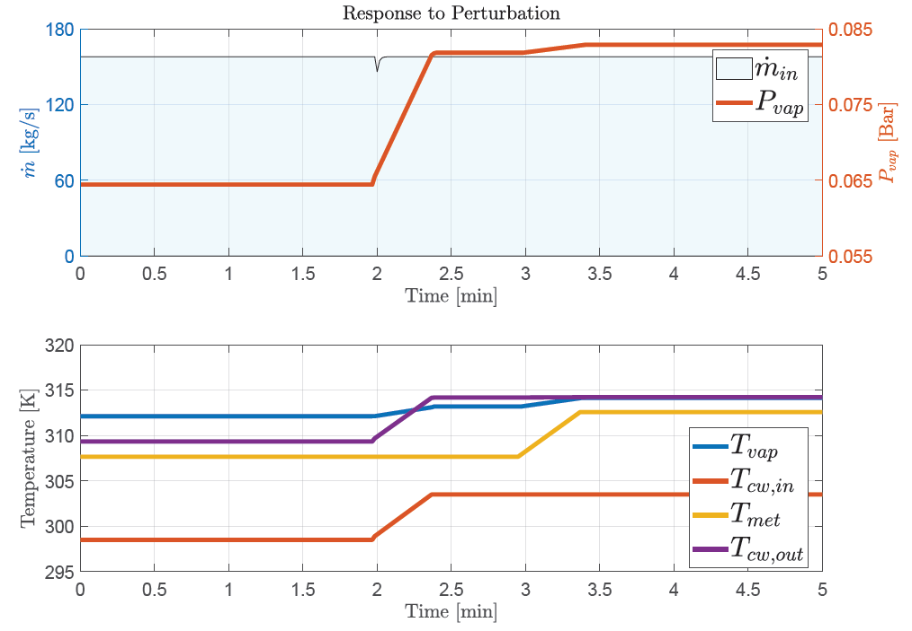
Results and Validation – Response to Perturbation

Slide 41
Conclusion
A mathematical model of CCPP condenser was developed using SPPA-T3000
Model captures thermodynamics of system
Logic switch between modes
Model was able to accurately predict performance.
Showed good agreement with Siemens provided data
Demonstrated response to perturbation consistent with acceptable thermodynamic behavior
Implementation of time-varying quantities ensured validity over a wide range of inputs

Slide 42
Future Research and Improvements
Resolve instability at low temperature/pressure operating conditions
Superheated steam HTC estimation
Attemperation
Implementation with HRSG, steam turbine, and pump models

Slide 43
Thank you
In collaboration with:

