Slide 1
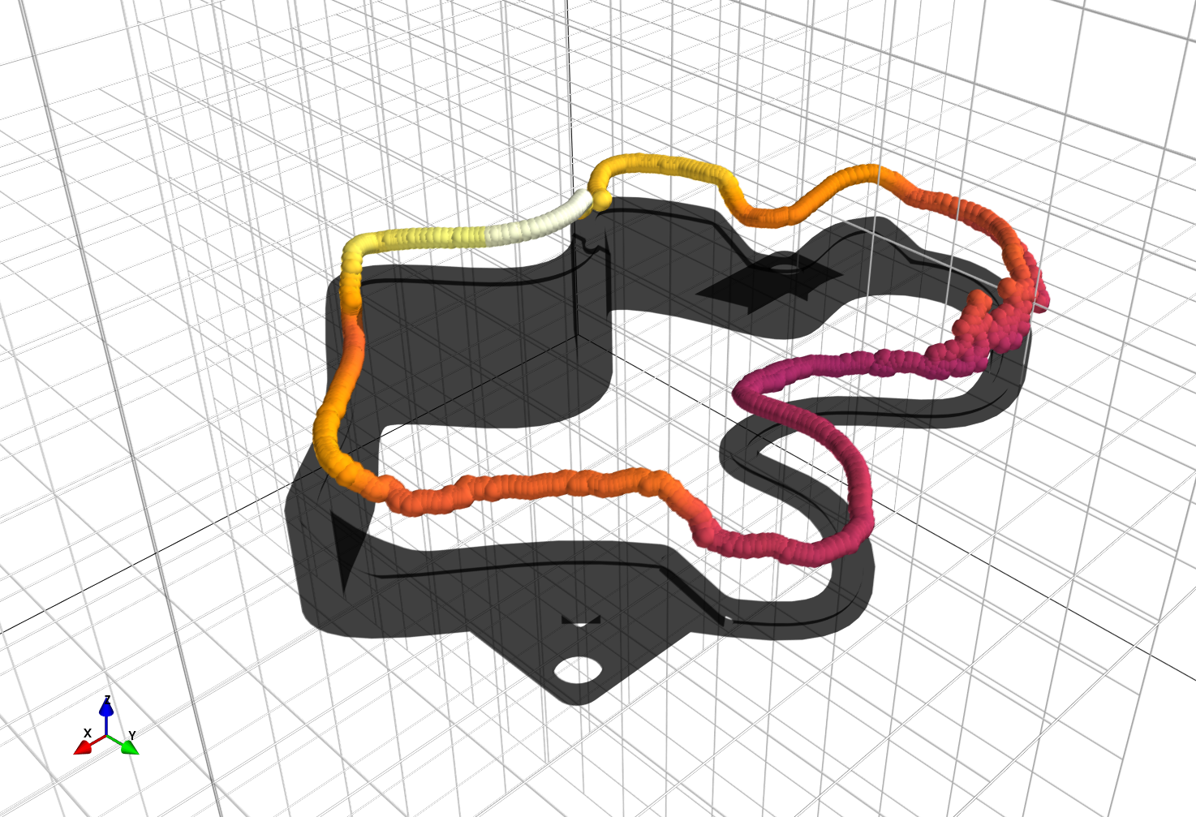
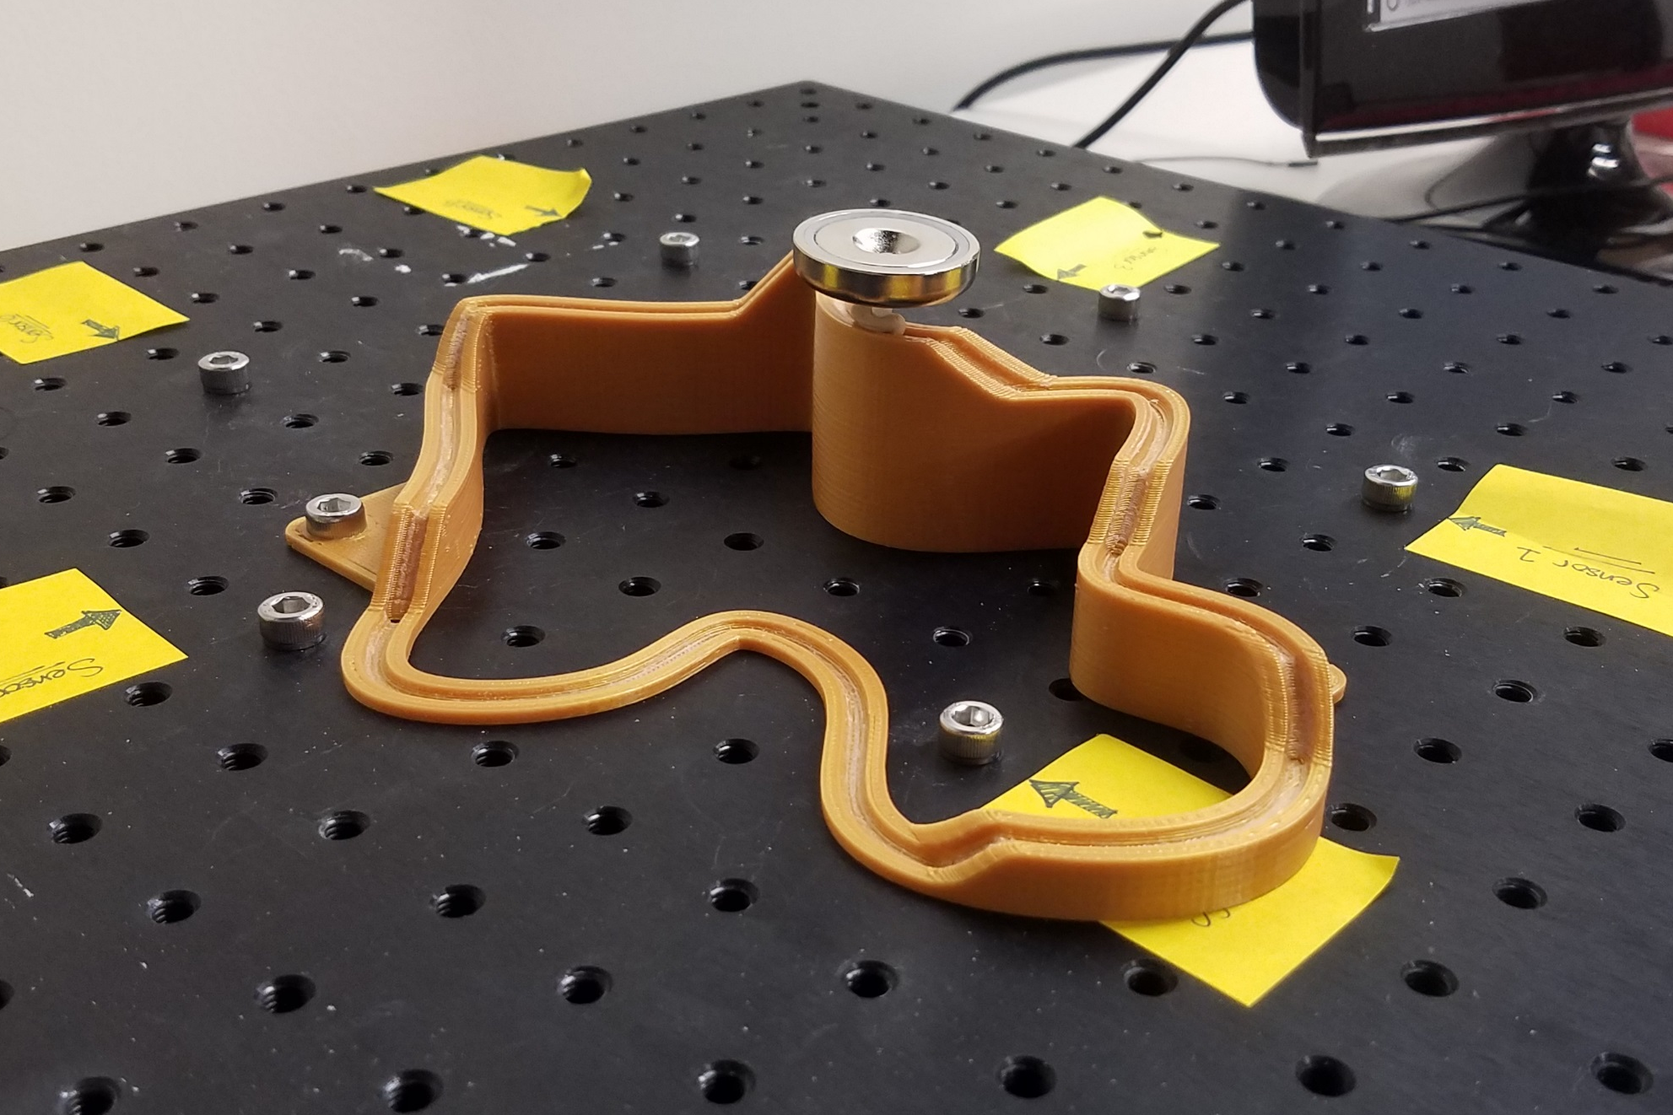
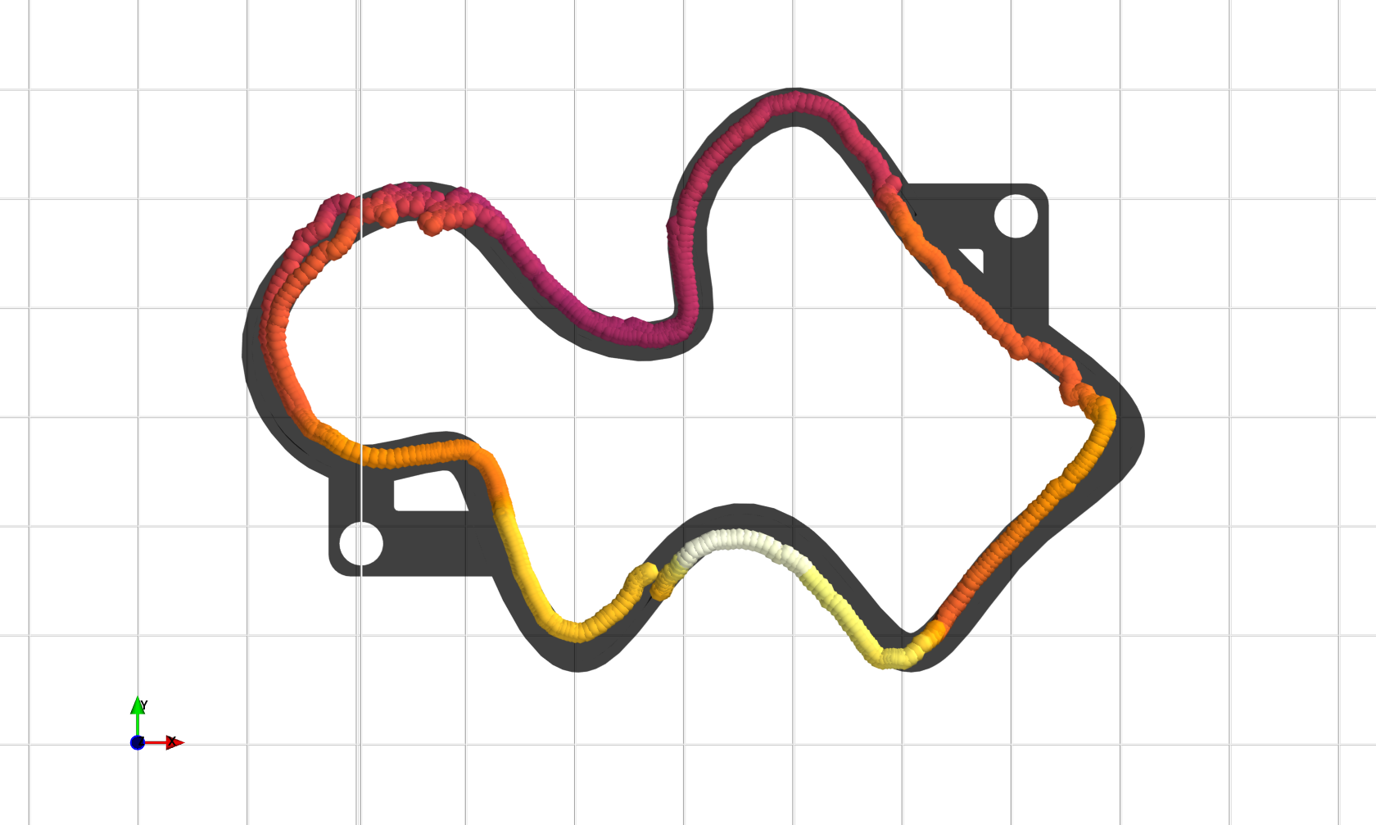
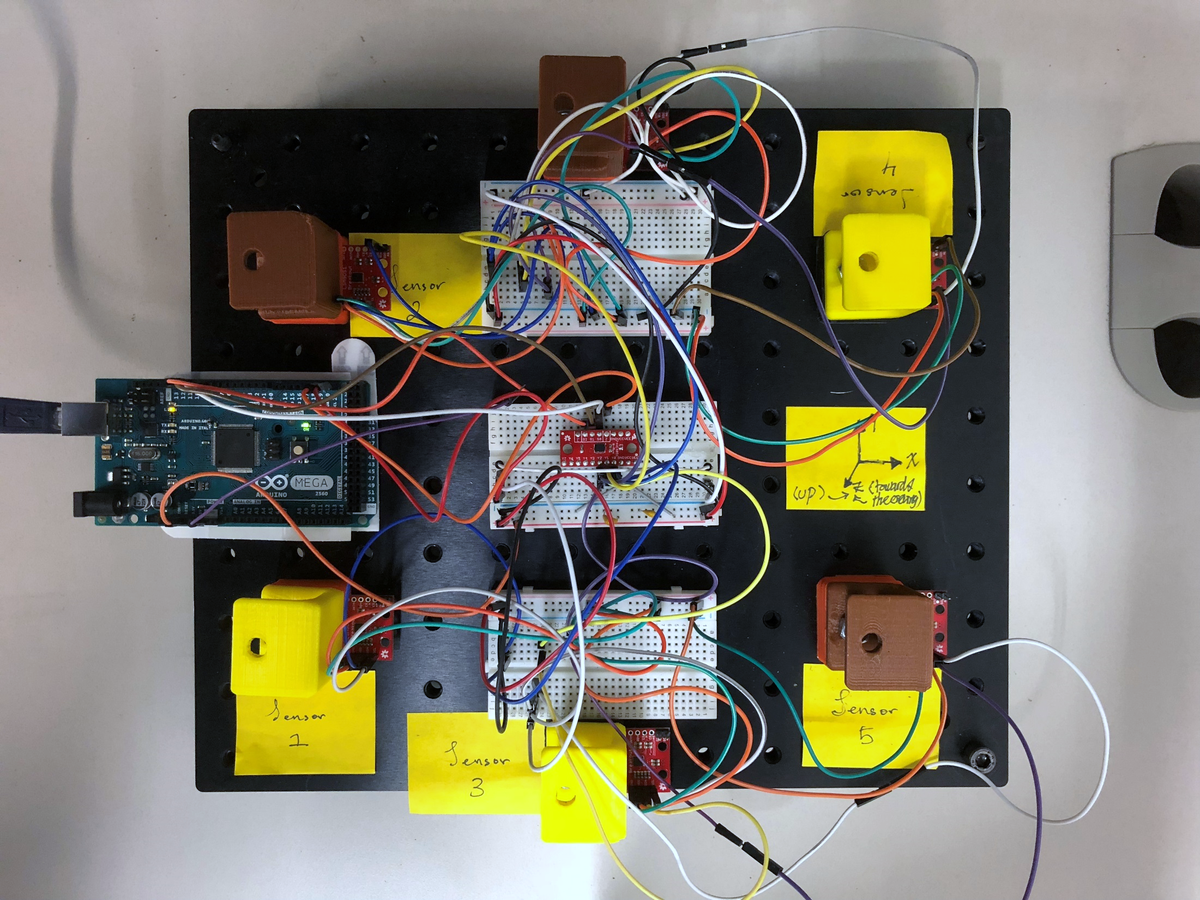
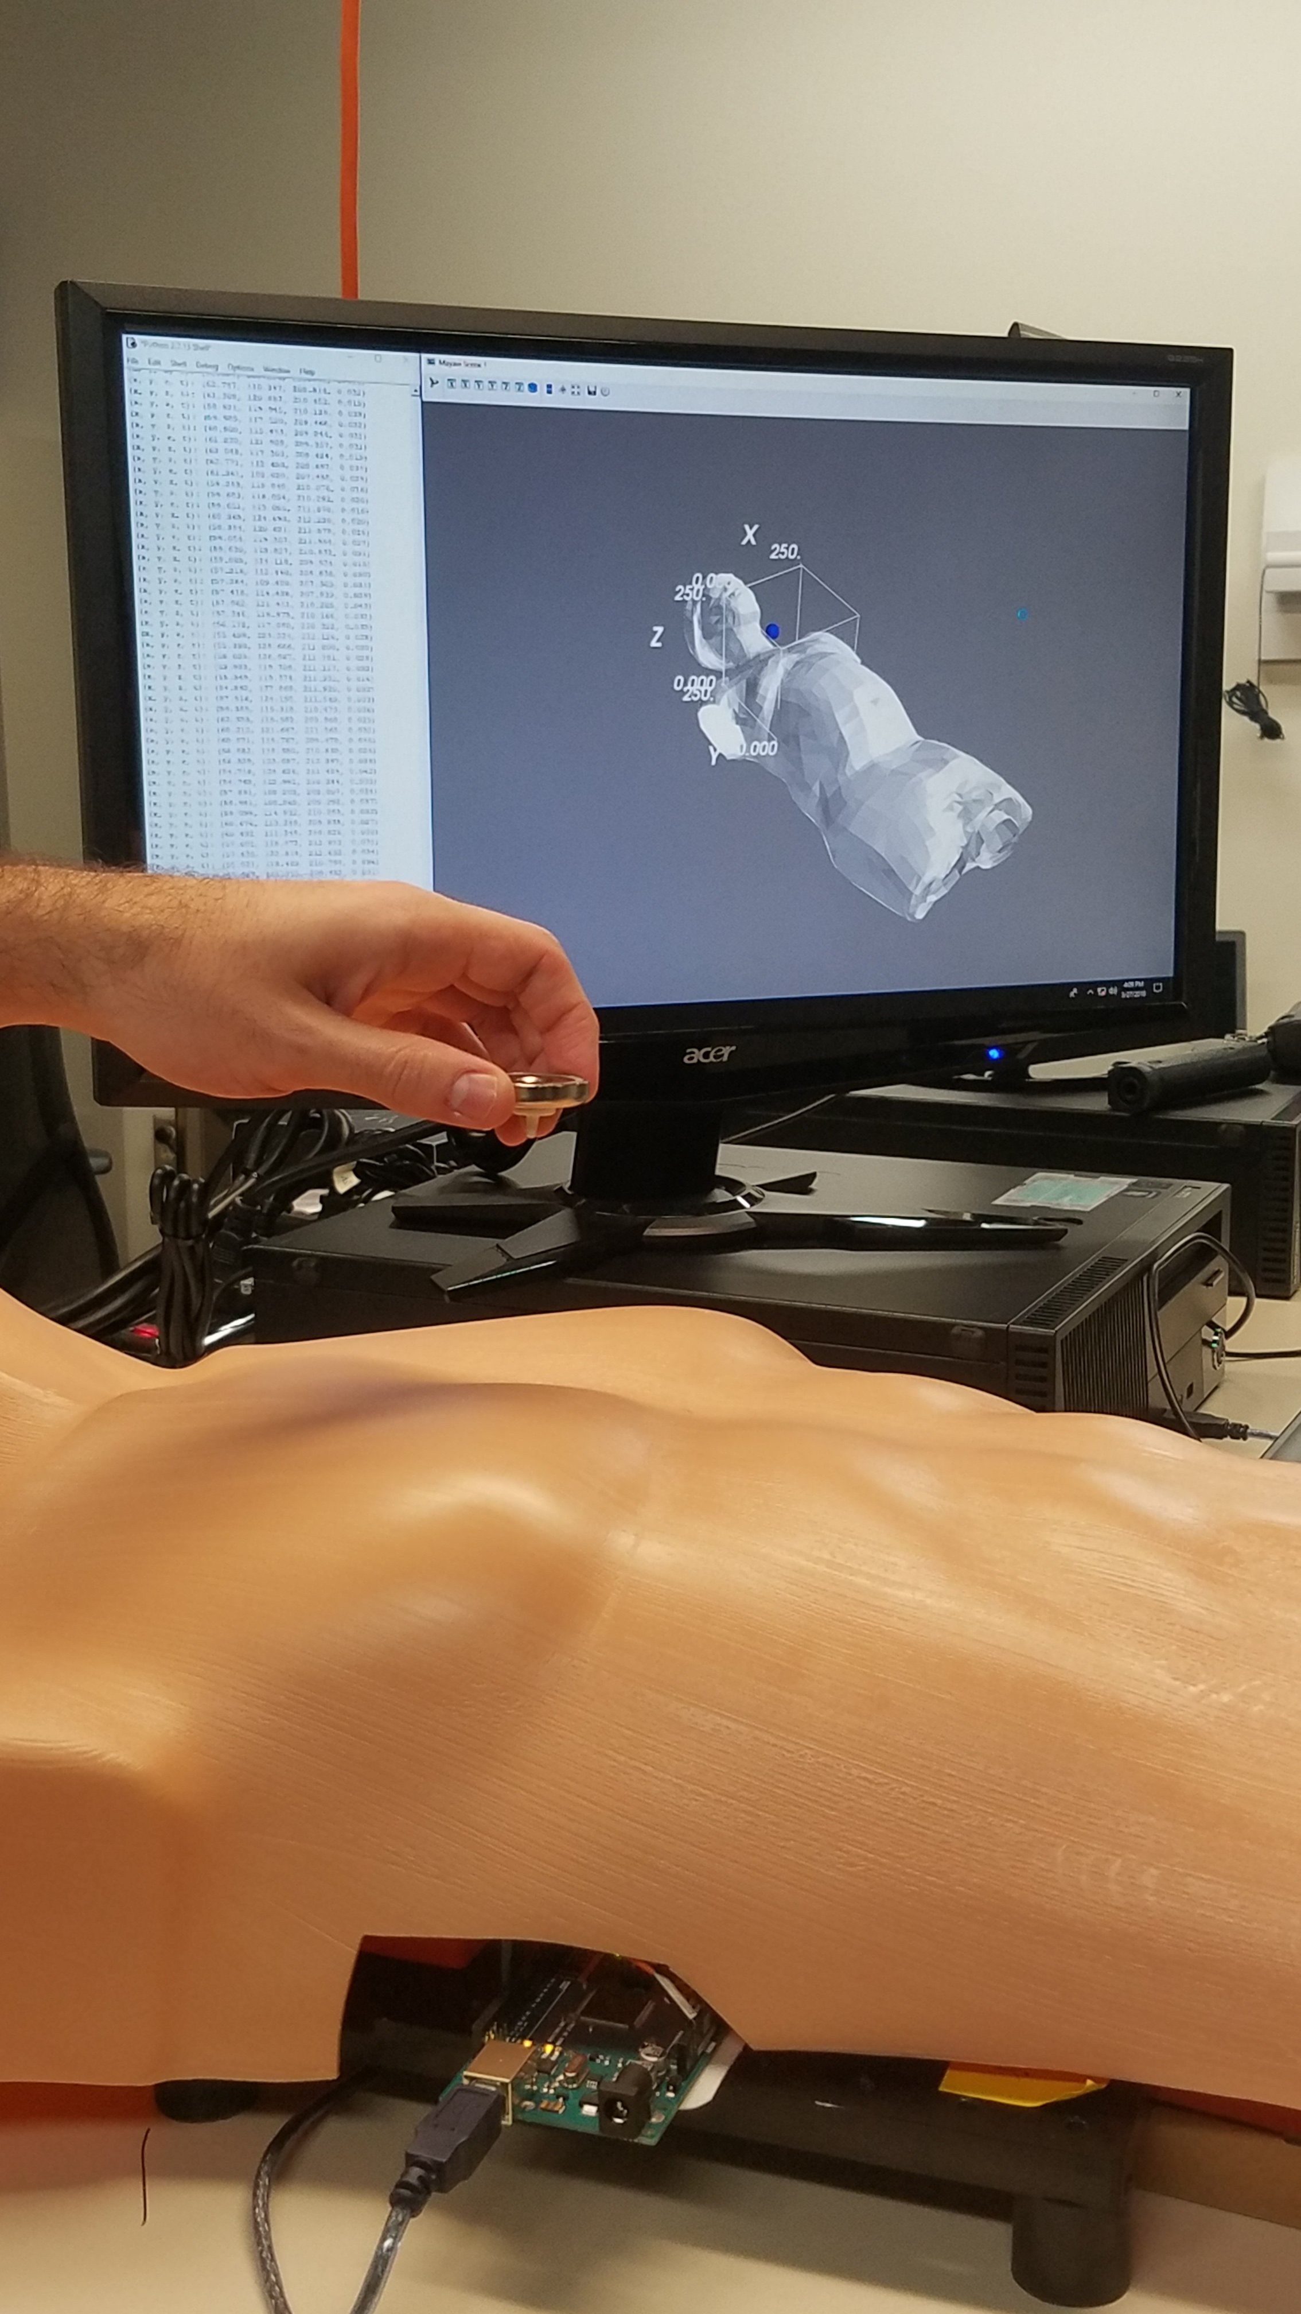
Real-time, non-contact tracking of medical devices and Surgical Tools
through the Analysis of Magnetic Field Vectors
Mohammad Odeh, Edward Daniel Nichols, Fluvio L Lobo Fenoglietto, Jack Stubbs
Institute for Simulation & Training, University of Central Florida 3100 Technology Pkwy, Orlando, FL 32826
Introduction
Minimally Invasive surgery performed both robotically and manually are increasing in adoption at a dramatic rate. As surgery systems continue to advance across a broad scope, the inherent technical requirement for spatial awareness data will only increase. For example, Renishaw’s neuromate and Accuray’s CyberKnife both require the precise location of fiducial markers to operate [1]. Surgeons performing teleoperations will benefit from the availability of high-quality, real-time, auxiliary sensor information that enables extension of their dexterity and spatial awareness. Providers will also deploy cost-effective user input systems for simulation programs designed to train aspiring and established healthcare professionals on using state-of-the-art medical tools.
To advance this field and to provide simulation inputs for our own training applications, The PD3D lab at the Institute for Simulation and Training has constructed a robust, scalable, highly-customizable, and non-intrusive system for dynamically tracking magnetized objects by taking advantage of well-characterized magnetic field properties.
Ultimately, this extremely low-cost proof-of-concept prototype serves as a foundation for exploring this approach to tracking surgical instruments and devices in the medical industry.
Results
Conclusions & Moving Forward
The most significant accomplishment of the work presented is the design and implementation of a non-contact, position tracking method and system using affordable, open-source hardware and software components. The system provides accurate position results ($Δx$= 1.01 mm, $Δy$ = -0.23 mm, $Δz$ = 2.44 mm, $E_{x}$ = 1.79%, $E_{y}$ = 1.49% and $E_{z}$ = 1.97% for N=18) and performs over a wider range than other similar applications [2].
Technical development will focus on improving the sampling rate and position calculation algorithms to make integration with existing equipment more viable; reducing the system footprint by implementing microcomputers like the Raspberry Pi 3; and by making the sensor array more modular will allow us to implement this design to additional configurations and applications.
A
C
B
D
9DoF IMU
Arduino Mega
Multiplexer
Ø=30 mm
25 mm
Figure 2: (A) Motion tracking of a 30mm annular permanent magnet along a 3D printed track; isometric view. (B) Motion tracking, top-view with 30mm magnet outline for reference. (C) Physical manifestation of the 3D track. (D) Layout of the sensor array, for the configuration used in the characterization of motion tracking performance.
Figure 3: THIS IS A PLACEHOLDING IMAGE
(Want laparoscopic surgery simulator setup.)
Materials & Methods
The nominal PD3D position tracking magnetometer array features six of Sparkfun’s breakout of the LSM9DS1 integrated sensors, engineered by STMicrolectronics [7], laid out on a planar hexagonal pattern. The array is driven by an Arduino compatible microcontroller, such as a PJRC Teensy 3.2 [4] or Arduino Mega 2560 [5], across an I2C bus multiplexed by an 8-channel 74HC4051 [6]. The data is then passed across the microcontroller’s Serial Bus to a custom Python [3] script on a computer. The array is firmly mounted to a base, such as an optical breadboard with M6 taps every 25mm, to ensure the relative locations of the sensors remain static and known.
Sensor data from only three magnetic field sensors is required to satisfy the non-linear system of equations [2] that yields the point estimate of position. An algorithm within the Python script identifies the three sensors nearest the permanent magnet, thus experiencing the highest magnitude effect of the induced magnetic field. The data from these sensors, ranging from 20mG to 16G, is processed by the Levenberg-Marquardt numerical method which is used to converge upon the point estimate within 2ms, enabling 3D position tracking in real-time.
References
Q. H. Li, L. Zamorano, A. Pandya, R. Perez, J. Gong, and F. Diaz, “The application accuracy of the NeuroMate robot— a quantitative comparison with frameless and frame-based surgical localization systems,” Computer Aided Surgery, vol. 7, no. 2, pp. 90–98, 2002.
Chen, K., Patel, S., and Keller, S. “Finexus: Tracking Precise Motions of Multiple Fingertips Using Magnetic Sensing” In Proceedings of the 2016 CHI Conference on Human Factors in Computing Systems (CHI 2016), ACM. pp: 1504-1514. San Jose, California, USA, May 7th-12th, 2016. DOI 10.1145/2858036.2858125.
Python, "Python 2.7“, [Online]. Available: https://www.python.org/. [Accessed 26 March 2018]
PJRC, “Teensy 3.2“, [Online]. Available: https://www.pjrc.com/teensy/. [Accessed 26 March 2018]
Arduino, “Mega 2560“, [Online]. Available: https://www.pjrc.com/teensy/. [Accessed 27 March 2018]
Nexperia, “74HC4051 8-Channel Multiplexer”, [Online]. Available: https://assets.nexperia.com/documents/data-sheet/74HC_HCT4051.pdf. [Accessed 27 March 2018]
STMicroelectronics, “LSM9DS1 IMU”, [Online]. Available: http://www.st.com/resource/en/datasheet/lsm9ds1.pdf. [Accessed 27 March 2018]
Figure 1: Live motion tracking of annular ring magnet above a modeled human thoracic region.
Notes:
Copyright Colin Purrington (http://colinpurrington.com/tips/academic/posterdesign).

